Slide 1
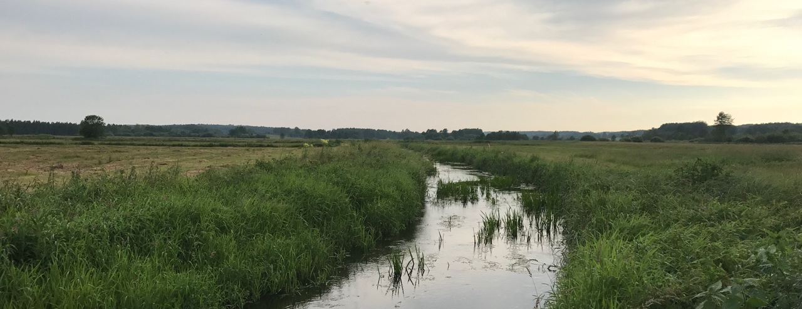
Cyberinfrastructure Center of Excellence Pilot
Funded by the National Science Foundation
Grant #1842042
Ewa Deelman, USC (PI)
Co-PIs: Anirban Mandal, RENCI
Jarek Nabrzyski, Notre Dame University
Valerio Pascucci and Rob Ricci, University of Utah

Slide 2
Overview
CiCOE Pilot project introduction and goals
Data Life Cycle (DLC)
DLC case study - IceCube Large Facility (LF)
DLC taxonomy across four LFs
Disaster Recovery (DR) in the context of DLC
DR planning case study – IceCube LF
Lessons learned from initial engagements
Feedback from participants

Slide 3

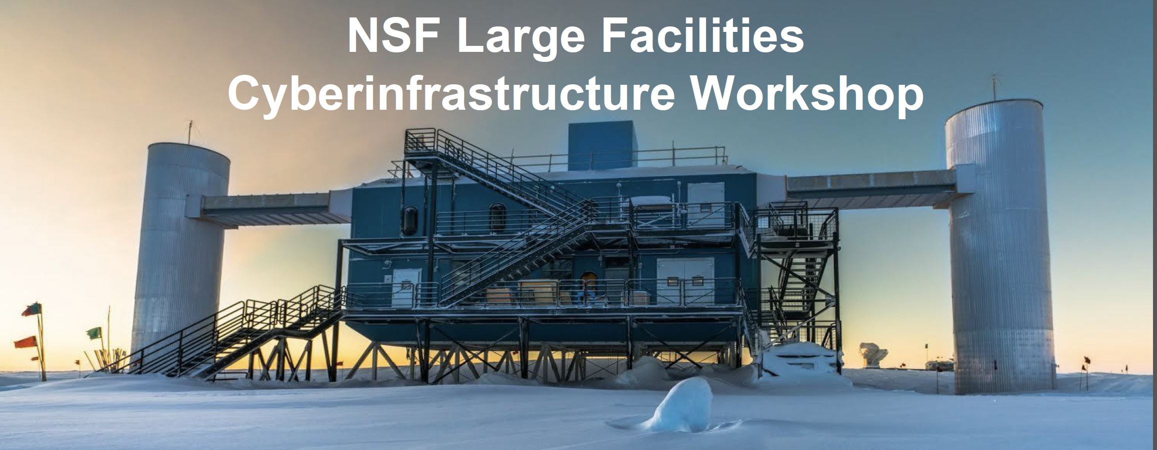
Recognizing the importance of CI in Large Facilities
Manish Parashar (PI and Chair), Rutgers University and OOI
Stuart Anderson, LIGO
Ewa Deelman, USC
Valerio Pascucci, University of Utah
Donald Petravick, LSST
Ellen M. Rathje, NHERI
Establish a center of excellence (following a model similar to the NSF-funded Center for Trustworthy Scientific Cyberinfrastructure, CTSC) as a resource providing expertise in CI technologies and effective practices related to large-scale facilities as they conceptualize, start up, and operate.
Foster the creation of a facilities’ CI community and establish mechanisms and resources to enable the community to interact, collaborate, and share.
IceCube
September 2017
Workshop report at http://facilitiesci.org/

Slide 4
Develop a model and a plan for a Cyberinfrastructure Center of Excellence
CI CoE Pilot Project Goals
Award #1842042
Platform for knowledge sharing and community building
Key partner for the establishment and improvement of Large Facilities with advanced CI architecture designs
Grounded in re-use of dependable CI tools and solutions
Forum for discussions about CI sustainability and workforce development and training
Pilot a study for a CI CoE through close engagement with NEON and further engagement with other LFs and large CI projects.

Slide 5
Data Life Cycle (DLC) and Disaster Recovery (DR) for Large Facilities
Team members
CICoE Pilot: Anirban Mandal, Laura Christopherson, Erik Scott, Ilya Baldin, Paul Ruth (RENCI)
NEON: Philip Harvey, Steve Jacobs, Tom Gulbransen (NEON Large Facility, Boulder)
IceCube: Benedikt Riedel (Wisconsin IceCube Particle Astrophysics Center)

Slide 6
Data Life Cycle and DR for LFs: Goals
Understand and document the best practices and solutions for data life cycle (DLC) and disaster recovery (DR) plans for Large Facilities (LFs).
Develop DLC model, taxonomy and DR planning models
a generalizable DLC model for LFs based on engagements with LFs: NEON, IceCube, and others.
a taxonomy of CI services, architectures, and functionalities that support the different DLC stages.
effective process guides for DR planning for LFs in the context of DLC stages.

Slide 7
Data Life Cycle for LFs
Initial data filtering/processing
Central data processing
Data Archiving and Storage
Data Access/Publishing/Distribution
WHAT?
Data Capture
WHERE?
main data center
main data center
some type of sensor or instrument (e.g. GRAPEs, telescope, DOMs)
often at the sensor site, or nearby
scientists/public
secondary data center(s)
secondary data center(s)
Different forms of transmission/movement (e.g., plane, satellite, cables), redundant network links,..
Data Movement
Disaster Recovery (DR)

Slide 8
Comparative Taxonomy for DLC and DR for Some LFs
DLC case study – IceCube Large Facility
IceCube materials courtesy: Dr. Benedikt Riedel, Wisconsin IceCube Particle Astrophysics Center

Slide 9
IceCube: About the Data
Data represents
hits
events – time period of interest with fixed read out window
metadata and secondary streams (e.g., time calibration, monitoring)
4 types of data
PFRAW - full data set originating at the South Pole (~3TB/day)
PFFILT Level 1 - ~100 GB/day of PFRAW that is filtered and send to UW-Madison
Level 2 - Level 1 data that has directional reconstructions and is "science ready"
Level 3 - Level 2 data that has been reduced, with extra reconstructions applied, by a particular science working group
Notes:
Alerts ?

Slide 10
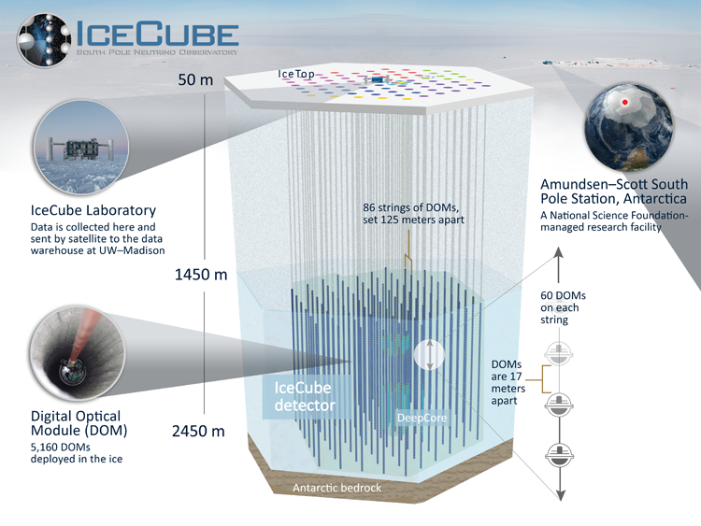
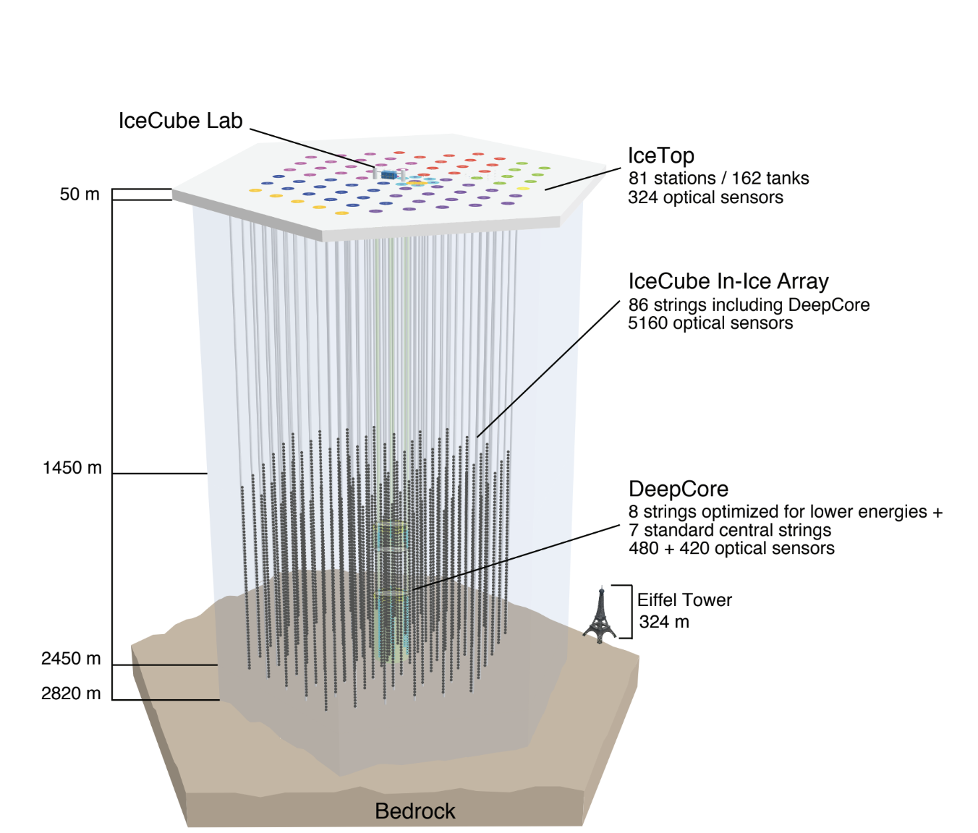
IceCube Data Life Cycle: Data Capture

Slide 11
IceCube Data Life Cycle: Initial Processing/Filtering
Initial filtering, processing: South Pole
Data is received by DOMHubs and IceCube Lab (surface of South Pole) - ~500 core filtering cluster; ~100 machines for detector readout; Hits are output as events.
Internal PnF system selects events based on their usefulness for a particular analysis. It also creates event metadata and reduces data volume before it is transmitted away from the South Pole.
Alert production is an important step that happens at the South Pole.

Slide 12
IceCube Data Life Cycle: Central Processing/Filtering
Central processing: UW-Madison processes what is sent from the South Pole to a “science ready level” or level 3.
UW-Madison 6500 core, 300 GPU cluster, ~10 PB storage
Additional downstream processing happens using a mix of resources: DESY, OSG, IceCube Grid (campus clusters, contributed resources, etc.), XSEDE allocations, DOE resources (e.g. NERSC)
Increased demand for GPU resources
PyGlidein + HTCondor based distributed computing middleware
Exploring cloud resources for CPU, GPU, ML

Slide 13
IceCube Data Life Cycle: Movement
Hits at DOMs
Sent to DOMHubs
Sent to Data Acquisition System (DAQ) - hits are output to events (PFRAW)
Sent to Processing and Filtering System (PnF) - PFRAW made ready for analyses
Sent to South Pole Station JADE for archival storage to disk (PFRAW and PFFILT/Level 1)
JADE transmits via satellite to UW-Madison (PFFILT)
PFFILT sent to DESY and PFRAW sent to NERSC for additional tape backups
Limited bandwidth of ~125 GB/day from South Pole to UW; 3TB/day raw data is filtered down to ~80GB/day and transmitted via satellite from South Pole Station to UW
Once a year, raw data from the South Pole is sent via plane and disks to UW-Madison
UW connected to SciDMZ through Starlight-ESNet for connection to DOE facilities
Leverages GridFTP for data transfers from UW-Madison to DESY/NERSC/OSG
In addition, Alerts are sent out using GCN (Gamma Ray Coordination Network - operated by NASA) or
Astronomical telegrams along with initial estimate of PFRAW data sample via satellite link to UW.

Slide 14
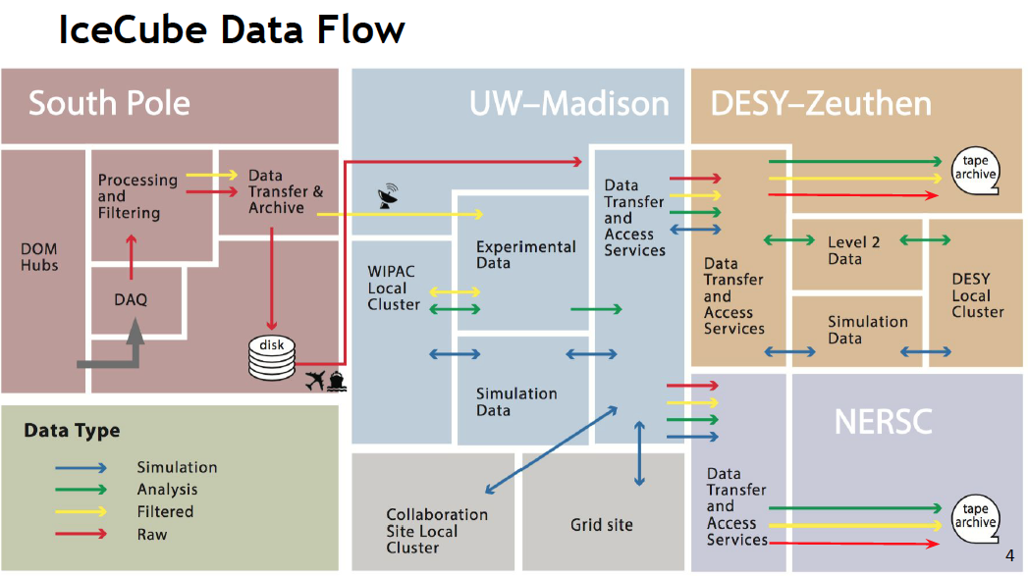
IceCube Data Life Cycle: Movement

Slide 15
IceCube Data Life Cycle: Archiving
JADE (archival system) exists in ~3 locations
South Pole JADE - writes 2 copies to disk (3 TB/day)
JADE North (UW) - warehouses the data to disk (~200 TB/yr)
JADE Long Term Archive (LTA) in DESY – keeps replicas of Level 1 and 2 data
NERSC archives PFRAW

Slide 16
IceCube Data Life Cycle: Access/Publishing/Distribution
Dissemination of Alerts
Alerts happen at the South Pole during Level 1 processing.
Alerting systems detect events and then an immediate alert is sent out using GCN (Gamma Ray Coordination Network - operated by NASA) or Astronomical telegrams along with initial estimate/small portion of PFRAW data sample via satellite link to UW.
When a full PFFILT data set is available at UW later, a refinement of the first alert is sent.

Slide 17
IceCube Data Life Cycle: Access/Publishing/Distribution
3 forms of data access eligibility:
Be a member of the IceCube Collaboration
Be an "associate member" which means one applies for use of the data for a particular purpose but is not required to fulfill collaboration obligations
By anyone using the public data pages on the web
Planned enhancements for data organization, management, access, and data catalog
Xrootd-based solution, Ceph/www
Data is released to members and associates. When the data has been analyzed and those analyses published, it becomes available for release to others.

Slide 18

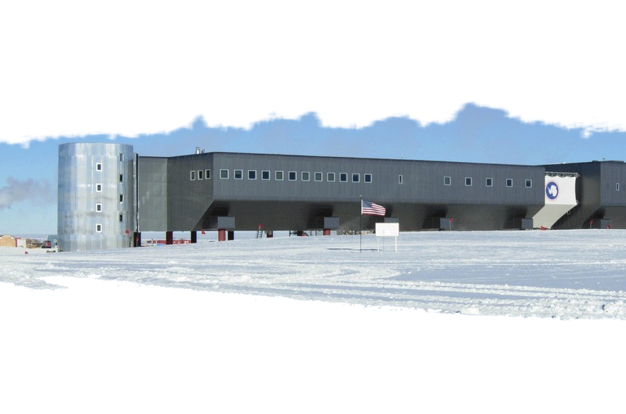

IceCube Logical Architecture
PFFILT
~125 GB/day bandwidth
100GB bundles
DESY
fiber
Replicates Level 1 and 2 from UW; Tape backup
½ of Level 2 processing
Grid: 384 cores, ~6300 HEPSpec O6
Storage: 360 TB dCache, 150 TB Lustre
Local CPU: 1000 cores, ~13,800 HEPSpec06
UW-Madison
6500 core, 300 GPU cluster
~10 PB storage
SciDMZ through Starlight
ESNET for connection to DOE facilities
Grid FTP
Amundsen-Scott
NERSC
Grid FTP
Replicates Level 2 and 3 from UW;
Tape backup
All PFRAW
disk 1/year
OSG, XSEDE, DOE
Facilities, Campus clusters
IceCube Lab
~500 core filtering cluster
~100 machines for detector readout
2 copies of all data archived
Other Processing
IceCube materials courtesy: Dr. Benedikt Riedel, Wisconsin IceCube Particle Astrophysics Center

Slide 19
Comparative Taxonomy for DLC and DR for Some LFs
DLC Taxonomy for LFs
NEON materials courtesy: Tom Gulbransen, Battelle
OOI materials courtesy: Dr. Ivan Rodero, Rutgers Discovery Informatics Institute
IceCube materials courtesy: Dr. Benedikt Riedel, Wisconsin IceCube Particle Astrophysics Center

Slide 20
About the Data
NEON | OOI | IceCube | LSST
6 levels of data L0: raw data L0’: raw data formatted for external use L1: unit conversions, time averaged, calibrated, quality checked L2: temporally interpolated L3: spatially interpolated L4: integrated data products such as indices or fluxes. 3 types of data observational samples (OS) instrumented systems (IS) aerial observatory platform (AOP) | Data comes from Cabled sensors (150kbps, .6 TB/yr) Uncabled sensors (440kbps, 70 TB/yr) Video (1.95 Gbps, 7.7 PB/yr) | Data includes: hits events metadata and secondary streams (e.g., time calibration, monitoring) 4 types: PFRAW - full data set originating at the South Pole (~3TB/day) PFFILT Level 1 - ~100 GB/day of PFRAW that is filtered and send to UW-Madison Level 2 - Level 1 data that has directional reconstructions and is "science ready" Level 3 - Level 2 data that has been reduced, with extra reconstructions applied, by a particular working group | 3 main types: Prompt/nightly including alerts released every 60 seconds and raw images released every 24 hours Data Release - prompt/nightly data that has been processed/filtered, released annually User Generated - Data Release that has been used by project teams and may be released to others as Data Release

Slide 21
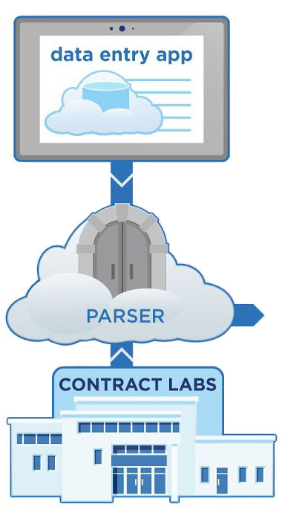
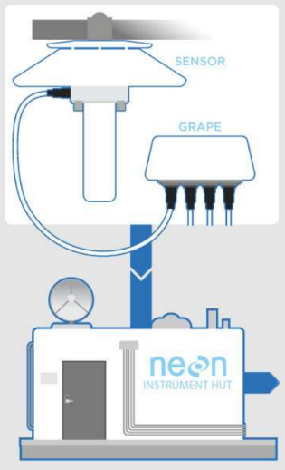
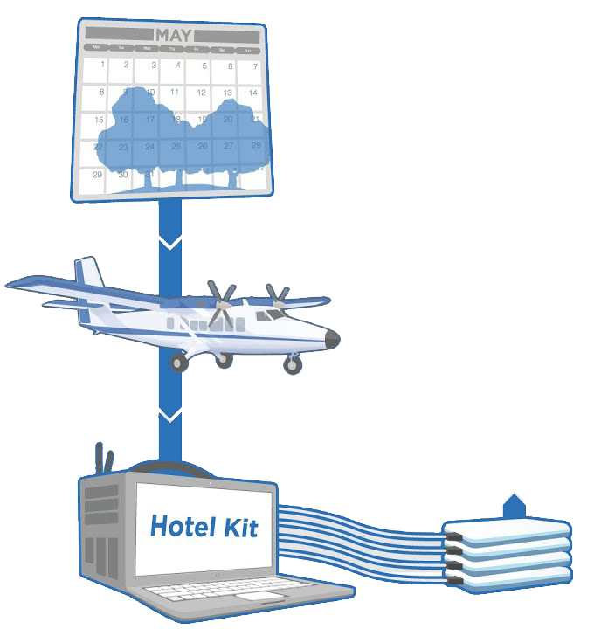
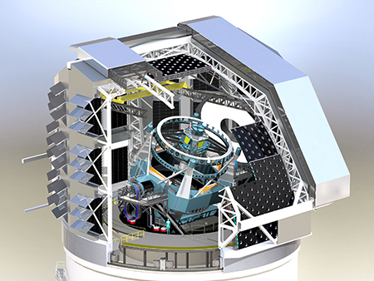
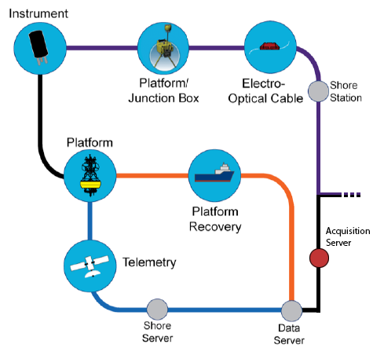
Data Life Cycle: Data Capture
NEON
LSST
IceCube
OOI

Slide 22
Data Life Cycle: Processing/Filtering
 | NEON | OOI | IceCube | LSST
Initial filtering, processing At/near Data Capture Location | Eddy covariance may be applied to IS data at field sites. | Drivers/parsers receive data from the acquisition pipeline shown in the previous slide. | South Pole: Data is received by DOMHubs and IceCube Lab (surface of South Pole) - ~500 core filtering cluster. Hits are output as events. Internal PnF system selects events based on their usefulness for a particular analysis. It also creates metadata and reduces data volume before it is transmitted away from the South Pole. Alert production is an important step that happens here. | Base Facility, La Serena Chile real time alert generation initial detector cross-talk correction metadata creation
Central processing At/near Data Center Location(s) | Iron Mountain Data Center (DEN-1) in Denver Apache Airflow (possibly use Pachyderm in future). All dockerized. Oracle PDR (OS data), Elastic Cloud Storage (IS data), Common Object Storage (AOP data) All transitions pipelines run in the data center. Heavy processing largely takes place in the VMWare resource cluster with metadata/data pulled from ECS and SC9000 SAN 476 total cores, 8.5 TB RAM (total) | Rutgers uFrame databases perform quality control, construct alerts/alarms, create calibration info, format the data, and generate metadata. Beyond this, P/F typically happens on demand when a user requests it. | UW-Madison processes what is sent from the South Pole to a “science ready level” or level 3, and coordinates simulation production. 6500 core, 300 GPU cluster ~10 PB storage Additional downstream processing happens using a mix of resources: DESY, OSG, IceCube Grid (campus clusters, contributed resources, etc.), XSEDE allocations, DOE resources (e.g. NERSC) Increased demand for GPU PyGlidein + HTCondor based distributed computing middleware Exploring cloud resources for GPU, ML | NCSA Nightly/Alert production 50% of Data Release production Calibration production moving object France the other 50% of Data Release production

Slide 23
Data Life Cycle: Movement
NEON | OOI | IceCube | LSST
OS data Collected on Fulcrum tablets. Tablets physically connected/uploaded to the network and parsed in pipeline parser. Loaded into the Processed Data Repository (PDR). Made available in the Data Portal. IS data Collected via Smart Sensors (SS)or GRAPES. Potentially logged, buffered, processed on site. Uploaded to the network. Data stored and processed in Elastic Cloud Storage (ECS). Metadata stored in Processed Data Repository (PDR). Made available in the Data Portal. AOP data Collected via hotel kits on the plane. Data is saved on a server in the plane. Server’s drives are removed and physically transported to common object storage in Elastic Cloud Storage (ECS). Processed in ECS. Made available in the Data Portal. | Cabled data Sent to a platform/junction box, then to an electro-optical cable Sent to a shore station Parsed Sent to the uFrame databases for other forms of processing (e.g., quality control, calibration) Algorithms are applied in uFrame Made available to users Physically recovered and telemetered data From the instrument to the platform Recovered (e.g., by ship) or sent via sattelite to a shore server. Then to an acquisition server Parsed uFrame framework and databases for more processing. Algorithms in uFrame Made available to users | Hits at DOMs Sent to DOMHubs Sent to Data Acquisition System (DAQ) - hits are output to events (PFRAW) Sent to Processing and Filtering System (PnF) - PFRAW made ready for analyses Sent to South Pole JADE for archival storage to disk (PFFILT/Level 1) JADE transmits via satellite to UW-Madison (PFFILT) PFFILT sent to DESY and PFRAW sent to NERSC for additional tape backups * Alerts sent via GCN or Astronomical telegrams along with small portion of PFRAW via sattelite link * Limited bandwidth of ~125 GB/day; 3TB/day raw data is filtered down to ~80GB/day and transmitted via satellite from South Pole Station to UW. * Once a year data from the South Pole (triggered) is sent via plane and disks to UW-Madison ~125 GB/day from South Pole to UW * UW connected to SciDMZ through Starlight-ESNet for connection to DOE facilities. * Leverages GridFTP for data transfers from UW to DESY/NERSC/OSG | Telescope Base Facility in La Serena, Chile NCSA, Illinois France Data Access Centers (DACs) (e.g. Base Facility, NCSA) 600 Gbps from Summit to Base 2 x 100 Gbps from Base to NCSA

Slide 24
Data Life Cycle: Archiving
NEON | OOI | IceCube | LSST
DEN-1 in Denver is the primary location for ingest, storage, transition and publishing. Data may be archived in several kinds of stores: file-oriented, relational databases, NoSQL database Automated data movement in and out of storage arrays Long-term source code control, archive, and version management Software: Oracle DB for PDR, elastic cloud storage, Drupal content management system Hardware: 104 cores assigned to replicated Oracle installations, two database portals, and bulk movement of data from the Oracle database environment into the bulk object storage Dell EMC SC9000 SAN general purpose storage 2 Dell EMC Elastic Cloud Storage replicates the data between each other Partners (e.g., DataONE) keep sync-ed caches of NEON data | Copies of data are kept by the two data centers and each partner keeps a copy of the data as well. Portland, OR - Cassandra cluster (~50TB) for raw, SAN (~2PB) for formatted/"gold", NAS for user access (~500TB); 126 dual-socket nodes; uFrame, VMware; 100GB network backbone Rutgers, NJ - Same as Portland except also includes a tape archive (~18PB) Overall capacity: 25PB storage, 126 servers (dual Xeon) Connected via redundant Internet 2 links (10GB). Portland mirrors Rutgers. Both store and provide computing infrastructure for the data. All sites are linked via VPN appliances. SAN, Cassandra, and VMWare are backed up to tape. | JADE (archival system) exists in ~3 locations South Pole JADE - writes 2 copies to disk (3 TB/day) JADE North (UW) - warehouses the data to disk (~200 TB/yr) JADE Long Term Archive (LTA) in DESY – keeps replicas of Level 1 and 1 data NERSC archives PFRAW data | Long term copies are stored in 3 locations: Base Facility NCSA France

Slide 25
Data Life Cycle: Access/Publishing/Distribution
NEON | OOI | IceCube | LSST
Data portal - Drupal-based website allows querying the collection API - Web services interface for external users Disk transport (e.g., AOP data) Integrated connections to partner organizations (e.g., AERONET, AmeriFlux, BOLD, MG-RAST, PhenoCam) 130 cores and 2.5 TB of RAM (aggregate) provisioned for access via web portals, database/data mart connectivity, and data export Currently moving from a 1Gps pipeline to a 5 Gps to allow higher speed access to data. This was slated to complete in June 2019. | Access means: OOI Data Portal THREDDS server Raw data on the website ERDDAP server Large datasets are available in NetCDF Data products can be generated on the fly both synchronously and asynchronously Data is served via the NAS | Alert dissemination Alerts happen at the South Pole during Level 1 processing. Alerting systems detect events and then an immediate alert is sent out using GCN (Gamma Ray Coordination Network - operated by NASA) or Astronomical telegrams along with initial estimate/small portion of PFRAW data sample via satellite link to UW. When a full PFFILT data set is available at UW later, a refinement of the first alert is sent. 3 forms of eligibility for access: Be a member of the Collaboration Be an "associate member" which means you apply for use of the data for a particular purpose but you are not required to fulfill Collaboration obligations By anyone and go through the public data pages on the web * Planned enhancements for data organization, management, access, and data catalog (xrootd, ceph/www) * Data is released to members and associates. When the data has been analyzed and those analyses published, it becomes available for release to others. | Access means: At a Data Access Center (currently at La Serena and NCSA) Using the Science Platform (can be used from home but fewer affordances than if used at a DAC) APIs

Slide 26
IceCube Logical Architecture
PFFILT
~125 GB/day bandwidth
100GB bundles
DESY
fiber
Replicates Level 1 and 2 from UW; Tape backup
½ of Level 2 processing
Grid: 384 cores, ~6300 HEPSpec O6
Storage: 360 TB dCache, 150 TB Lustre
Local CPU: 1000 cores, ~13,800 HEPSpec06
UW-Madison
6500 core, 300 GPU cluster
~10 PB storage
SciDMZ through Starlight
ESNET for connection to DOE facilities
Grid FTP
Amundsen-Scott
NERSC
Grid FTP
Replicates Level 2 and 3 from UW;
Tape backup
All PFRAW
disk 1/year
OSG, XSEDE, DOE
Facilities, Campus clusters
IceCube Lab
~500 core filtering cluster
~100 machines for detector readout
2 copies of all data archived
Other Processing
IceCube materials courtesy: Dr. Benedikt Riedel, Wisconsin IceCube Particle Astrophysics Center

Slide 27


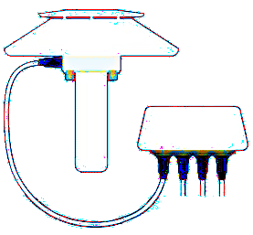




NEON Logical Data Flows
DEN-1 Central Data Center
sensor/GRAPE
location controller
DEN1
DEN2
IS data
replicated
tablet
parser
Dell EMC SC9000 SAN
Utility storage for VMs, databases, and NAS
OS data
Dell Elastic Cloud Storage (ECS)
DEN1 Primary (2PB)
DEN2 Replica (2PB)
DEN3 Development (200TB)
pony express
drives
Data Portal
hotel kit
Syncs/Backups
DEN1Primary synced with AWS Glacier Deep Storage offsite
Unitrends Backup Server (160 TB) in DEN-1 with replica in Boulder HQ
Veeam and Backup Server in DN-1 with replica in Boulder HQ
AOP data

Slide 28
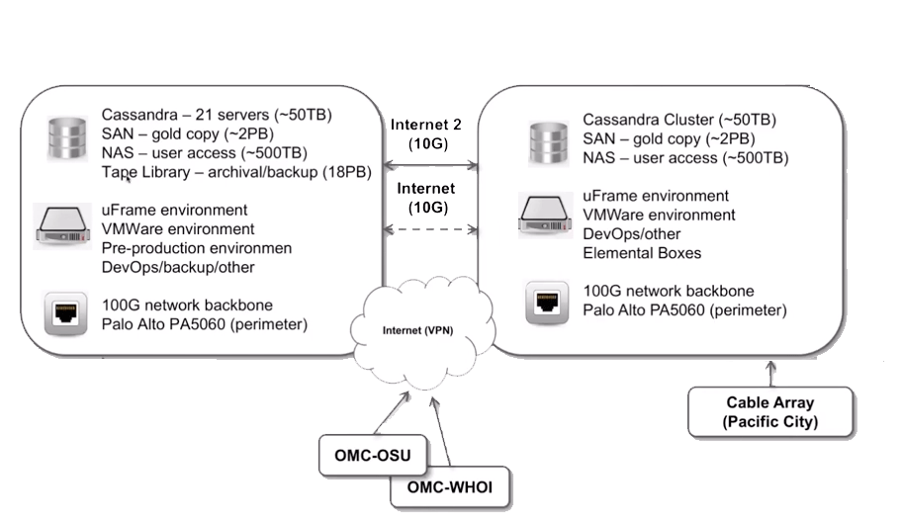
OOI Logical Architecture
East Coast CI (Rutgers)
West Coast CI (Pittock)
* OOI materials courtesy: Dr. Ivan Rodero, Rutgers Discovery Informatics Institute

Slide 29
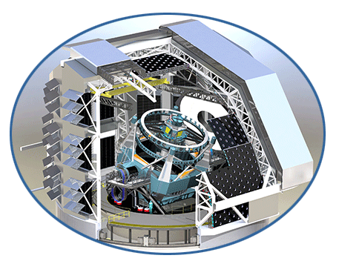
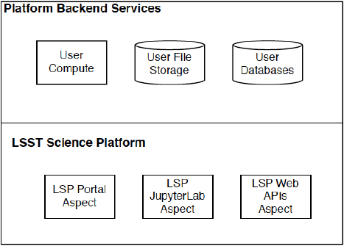
LSST Logical Architecture
Base Facility, La Serena
NCSA
(Data Access Center)
(Data Access Center)
Summit Facility
Cerro Pachon
Telescope
Processing
real time alert generation
initial detector cross-talk correction
metadata creation
Computing: ~ 2400-3000 cores
File storage: ~ 4 PB (user file workspace)
DB storage: ~ 3 PB (user DB storage)
Data retention of Nightly and Data Release
Copy 1 of data
Processing
Night/Alert production
50% of Data Release
Calibration production
moving object
Computing: 18,000 cores
File storage: ~ 24 PB
DB storage: ~30 PB
Copy 2 of data
CC-IN2P3, France
Processing
the other 50% of Data Release
Copy 3 of data
600 Gbps
2x 100 Gbps

Slide 30
Disaster Recovery (DR)
Disaster Recovery (DR) in the context of DLC

Slide 31
Existing Disaster Recovery (DR) Strategies for Some LFs across the Data Life Cycle
 | Data Capture | Processing/ Filtering | Data Movement | Data Archiving and Storage | Data Access
NEON | GRAPES can buffer up to 1 month of data. Smart sensors have limited buffering capability. Replace GRAPE if fails. | No failover for compute - onsite or offsite. | If 2nd data center is built, we might see some replication there (TBD). | Replication (cloud) using AWS S3 Glacier Deep Archive for backup of ECS. ECS is replicated on site at DEN-1 Backups performed by different appliances depending on the type of storage. Plans for 2nd data center in Wyoming (for just data replication). | No existing DR strategies. Fail overs? Availability guarantees? SLA?
OOI | Replacement? How long is this data kept in retrieval locations (e.g., Pacific City)? How much is buffered or cached? | West Coast isn't used for processing but could be. Has plans for failover. | Redundant network links between East and West. | West Coast replicates data from East Coast. No automatic failover, but has plans. | Failovers planned for user access. Availability guarantees? SLA?
IceCube | Replace with a spare. | Good separation between remote and central processing. Distributed processing provides resilience. | Different ways to transmit - plane, sattelite, Internet. GridFTP to both DESY and NERSC. | At least 4 copies of data in different locations: 1 copy kept at the South Pole, 1 each in UW, DESY and NERSC. | No formal SLA. Varies based on the caching solution (e.g. xrootd).
LSST | Base Facility has a copy of data. Significant buffering planned for anticipated network failures. | Multiple facilities do processing of different types. No failover or redundant processing capabilities. | Redundant connection from BASE to NCSA. Protection against network failures for Summit to Base and from Base to NCSA | 3 copies of data reside in different places: Base facility in Chile, NCSA, CC-IN2P3 (France) | Different means of access including different Data Access Centers, via web, via APIs. Availability guarantees? SLA?
Strategies for LFs | Caching/buffering Backup copies Replace with a spare | Failover compute sites? | Plans for failover Redundant connections | Data replication Backup services | Automatic failovers for data access Multiple data access points

Slide 32
Disaster Recovery (DR) Effective Processes
Cross-cutting finding: Although some DR strategies exist across some stages of the DLC for some LFs, DR hasn’t been taken into account to the fullest extent it warrants when designing the CI architecture for LFs.
There is a need for some careful consideration of requirement analysis and planning for DR as an effective process to be followed before and after a possible disaster.
Developing an effective processes guide for planning for Disaster Recovery for LFs
DR Planning Phase template that Large Facilities can follow for planning for Disaster Recovery.
Based on federal guidance for developing an Information System Contingency Plan (ISCP) after doing a thorough Business Impact Assessment (BIA) – NIST 800-34r1 (https://nvlpubs.nist.gov/nistpubs/legacy/sp/nistspecialpublication800-34r1.pdf)

Slide 33
Disaster Recovery Effective Processes: ISCP
Information System Contingency Planning (ISCP) major steps
Overview: Top-level view of CI DR needs of the LF and serves as a summary and context.
Conduct Business Impact Analysis (BIA)
Mission, data life cycle, and recovery criticality: CI for the entire data life cycle is identified and impact of disruption to those systems is determined along with outage impacts and estimated downtimes.
Resource requirements: Thorough evaluation of resources required to restore systems and processes supporting the data life cycle and related interdependencies.
Recovery priorities for system resources: Link system resources to critical mission and business processes for LFs and establish priority levels for sequencing recovery activities and resources.
Create Contingency Strategies
(a) Backup and Recovery; (b) Backup methods and Offsite Storage; (c)Alternate Sites; (d) Equipment Replacement; (e) Cost Considerations; (f) Roles and Responsibilities; )g) Plan testing, training and exercises
We have created example DR Planning Phase templates for NEON and IceCube and
engaged with them to validate and refine the template. We plan to engage with other LFs.
Notes:
Note the difference between planning phase and responding phase

Slide 34
Disaster Recovery (DR)
DR Planning case study – IceCube LF

Slide 35
DR Effective Processes: BIA: Mission, DLC, Criticality
Mission and data life cycle example (IceCube)
Mission/Business Process | Description
Collect observational data for scientific inquiry | Operate an array of photodetectors buried in a cubic kilometer of ice at the south pole
Ingest data from sensors for further use | Operate networks at the south pole, satellite and physical data transport to UW-Madison, and bulk internet transfer to DESY-ZN and to NERSC (National Energy Research Scientific Computing Center). Notification of neutrino events to worldwide observatories, both radio and optical.
Process data for QA, events, and production of private and public datasets | Operate clusters of computers to analyze data for interesting events, QA, and calibration. Data reduction for low bandwidth satellite link.
Archive data for future use | Operate a curated repository of collected and processed data redundantly copied across three institutions.
Disseminate data | Provide alerts for interesting astrophysical events, i.e. during L1 analysis, if an event of interest is detected, an alert is sent out immediately. Operate an access portal to support querying the collection and accessing the stored and/or computed results. Provide well documented access methods and ensure that access methods can be added into the far future as needed.

Slide 36
DR Effective Processes: BIA: Mission, DLC, Criticality
Recovery Criticality – Outage Impacts example (IceCube)
Data Life Cycle Stage | Impact Category
 | Mission Impact | Science Return | Cost | Impact
Collect observational data for scientific inquiry | Severe | Severe | Severe | Severe
Ingest data from sensors for further use | Severe | Moderate | Moderate | Severe
Process Data for Multimessenger GCN Alerts | Severe | Severe | Moderate | Severe
Process data for QA, and production of private and public datasets | Moderate | Moderate | Minimal | Moderate
Archive data for future use | Severe | Severe | Severe | Severe
Disseminate data - Alerts | Severe | Severe | Minimal (short term) | Severe
Disseminate data – Level 2+ processed products | Moderate | Minimal | Minimal | Moderate
Outage Impacts
Impact category:
{Severe, Moderate, Minimal}

Slide 37
DR Effective Processes: BIA: Mission, DLC, Criticality
Recovery Criticality – Estimated Downtimes example (IceCube)
Data Lifecycle Stage | MTD | RTO | RPO
Collect sensor data for scientific inquiry – operation of the actual sensors | 1 hour | 1 hour | N/A
Ingest data from sensors for further use | Optical DOMs to IC Lab: 2 days; IC Lab to South Pole Lab: 6 months | 1 day from DOM; 1 month from lab to station | 1 day
Process data for QA, events, and production of private and public datasets | Events: 1 hour; All others: 1 month | Events: 30 minutes; Others: 4 days | Equal to recovery time
Archive sensor data for future use | 6 months w/ no loss | 1 hr | 1 day
Disseminate data - alerts | 6 hours | 3 hours | None
Dissemination – Level 2+ | 1 year | 1 month | 1 day
Estimated Downtime
MTD: Maximum Tolerable
Downtime
RTO: Recovery Time Objective
RPO: Recovery Point Objective

Slide 38
DR Effective Processes: BIA: Resource Requirements
Resource requirements example (IceCube)
For each step in the Data Lifecycle and the identified level of recovery criticality, describe resources used for day-to-day operation and the resources needed for recovery in the event of an outage.
System Resource/Component | Platform/OS/Version (as applicable) | Description
Collect observational data for scientific inquiry | DOMs (custom) | Sensors buried in the ice. Also power, IceCube Laboratory Facilities, staff
Ingest data from sensors for further use | Data communication to DOMs, network to South Pole Station, rest of world | Communications from DOMs, network to South Pole station, satellite and sneakernet to rest of world. JADE software for archive and distribution worldwide.
Process data for QA and for computed results | Server clusters, other CPU/GPU resources, HTCondor compute middleware, data distribution software | Datacenters at IceCube Lab and South Pole Station with special challenges. Data centers at UW-Madison, DESY, and NERSC. Distributed computing on OSG, XSEDE, DOE resources.
Archive sensor data for future use | JADE | Long term archive and archive management
Disseminate data | Web servers, data access/distribution middleware | Public-facing Portal, other data distribution methods (xrootd, ceph etc.)

Slide 39
DR Effective Processes: BIA: Recovery Priorities
Recovery priorities example (IceCube)
Priority | System Resource/Component | Recovery Time Objective
1 | Collect environmental data for scientific inquiry | 1 hour
4 | Ingest data from sensors for further use | Optical DOMs to IC Lab: 1 day; IC Lab to South Pole Lab: 2 months
5 | Process data for QA and for intermediate results | Events: 30 minutes Others: 4 days
3 | Archive sensor data for future use | 1 hour
6 | Disseminate data – Level 2+ | 1 month
2 | Disseminate Alerts | 3 hours

Slide 40
Data Life Cycle and DR Planning: Lessons Learned
DLC is ONE way to learn, reason and catalog the CI functionalities at each stage of data operation for LFs.
DLC abstraction helps reasoning about
What services are offered by each DLC stage ?
What CI architectural elements support each DLC stage ?
There are both fundamental commonalities and differences across LFs for DLC.
Devil is in the details for both for DLC and DR; Many a time, specific elements or types of data are prioritized.
Heterogeneity of data processing – the set of processes handling the data differs according to the type of data.

Slide 41
Data Life Cycle and DR Planning: Lessons Learned
Heterogeneity of tools and CI stacks.
DR planning template was a good way to start thinking about disaster recovery – a framework to document and prioritize CI architecture and operations.
DR planning template can be used by LFs to quantitatively justify CI elements for construction or future enhancements.
Effective communication between LF CI professionals and CiCOE Pilot team was key to thorough understanding; Documentations and reports are necessary but not sufficient.

Slide 42
Thank you !!
Questions ?
Feedback

